Slide 1
Progress Report
HIAD optimization
Week 13
Progress Report Aug 27, 2026
Sidenote: StretchedProgress Report Sep 3, 2026 & Sep 8, 2026

Slide 2
Target
Progress Report Aug 27, 2026

Slide 3
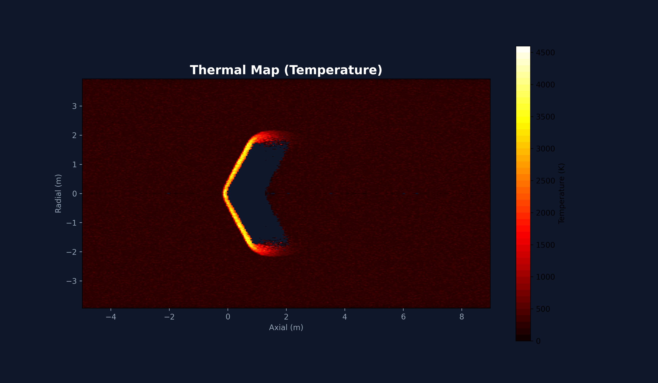
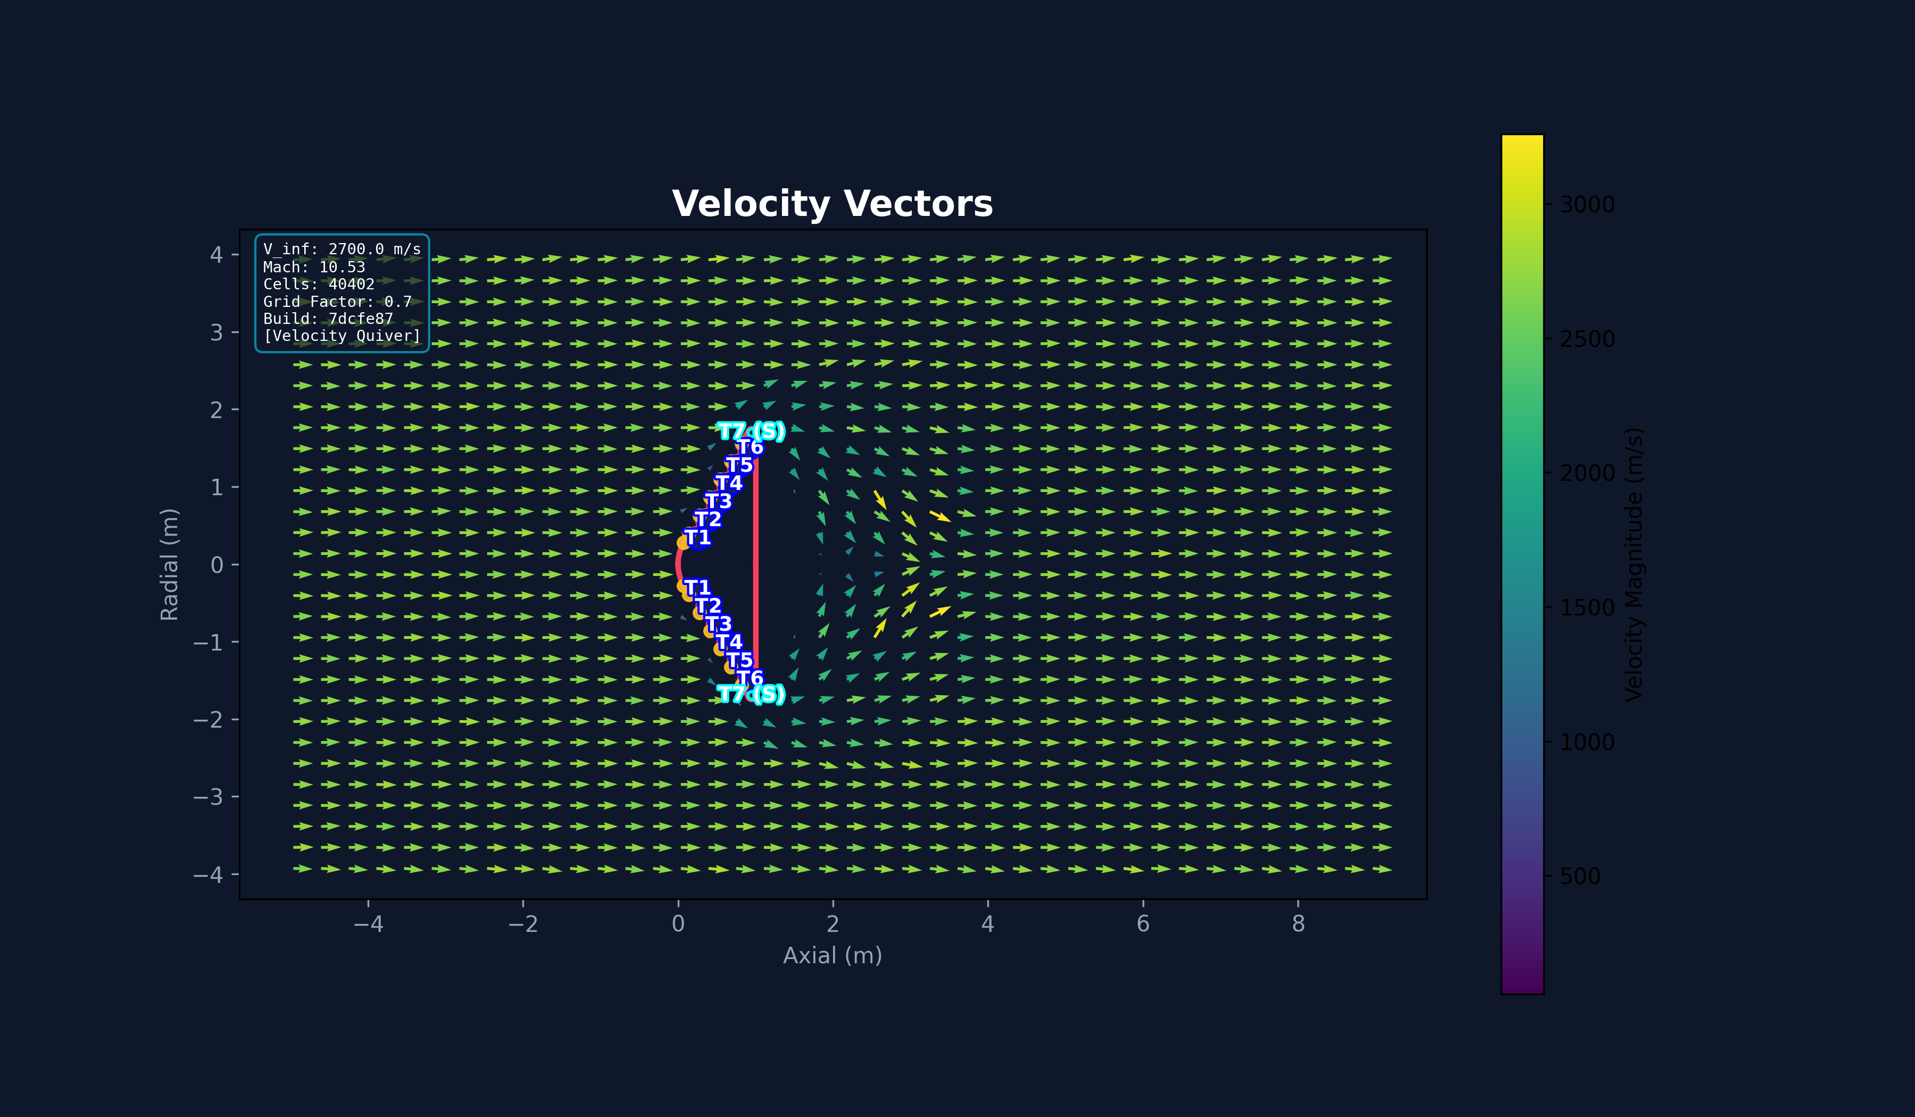
Here’s the previous problem
Previous Issue
Wrong Parameter Model And also Diagnosing the issue with Peak heat Flux issue why it is going > 100 W/cm^2
Progress Report Aug 27, 2026

Slide 4

Transition Programming Language For Orchestrator and Post Processor In order to get Auto Theorem prover GNATprove Why3 <->(cvc5, z3, alt-ergo)
Pure Python
SPARK 2014 Hybrid Python
Progress Report Aug 27, 2026

Slide 5

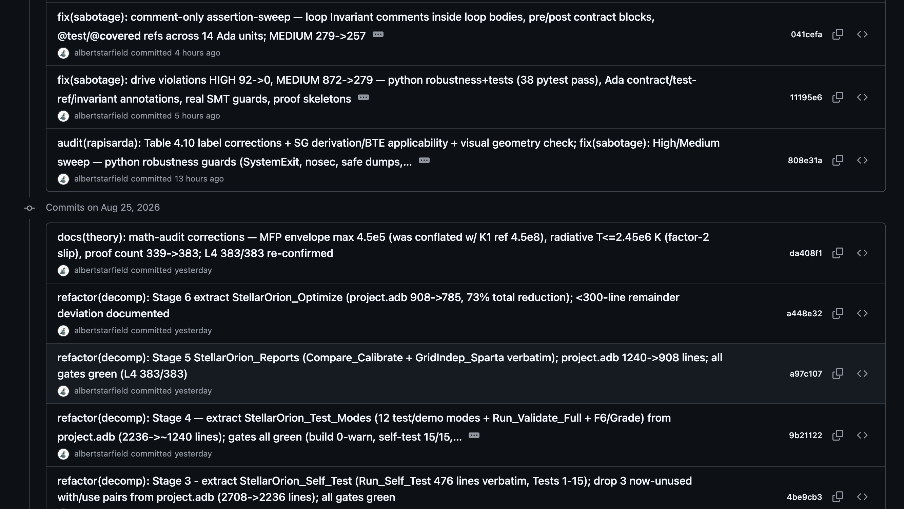
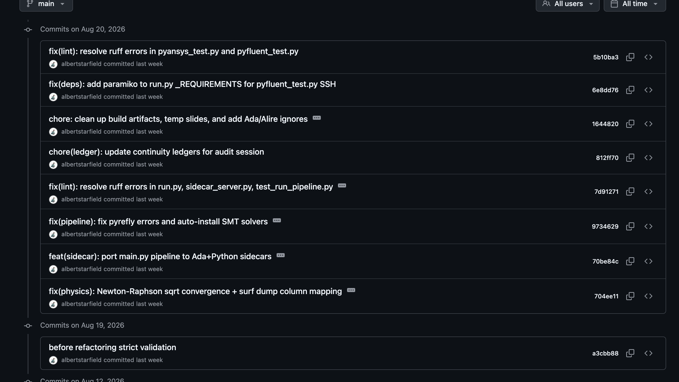
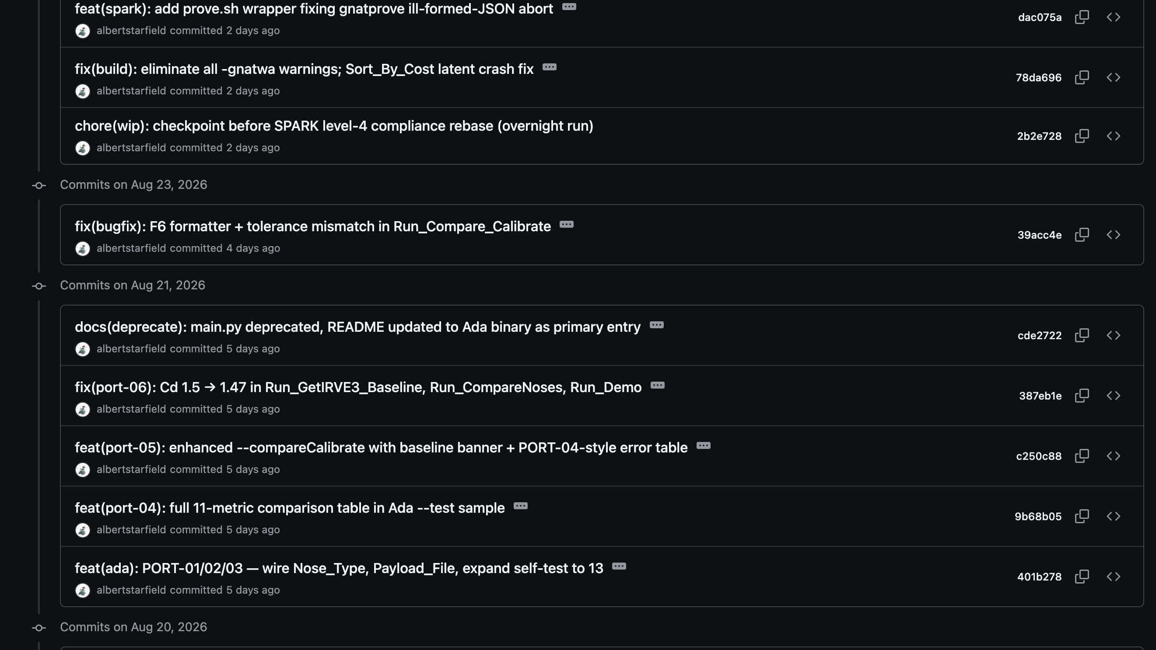
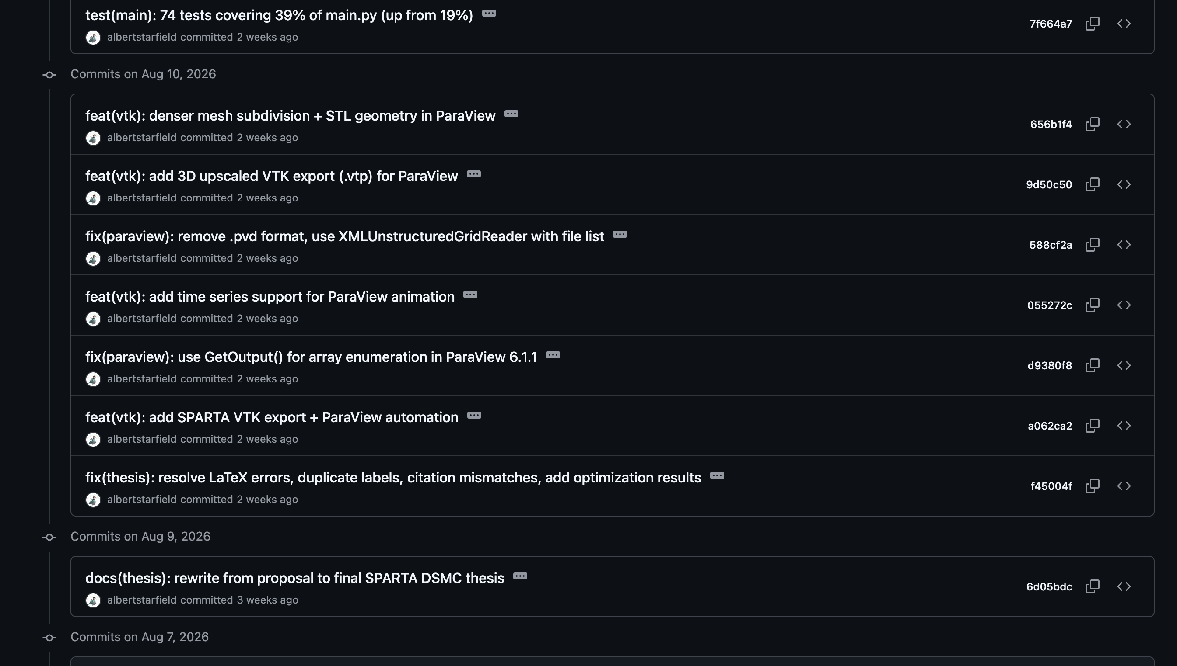
Transition finished
Transition happened from July to August.
Progress Report Aug 27, 2026

Slide 6
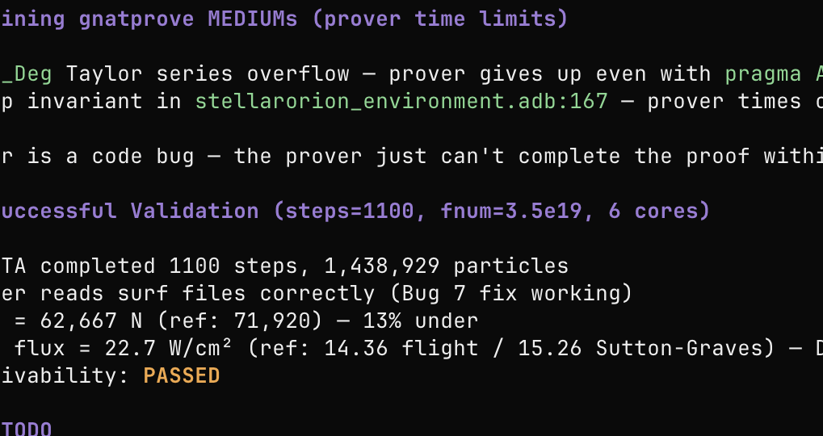
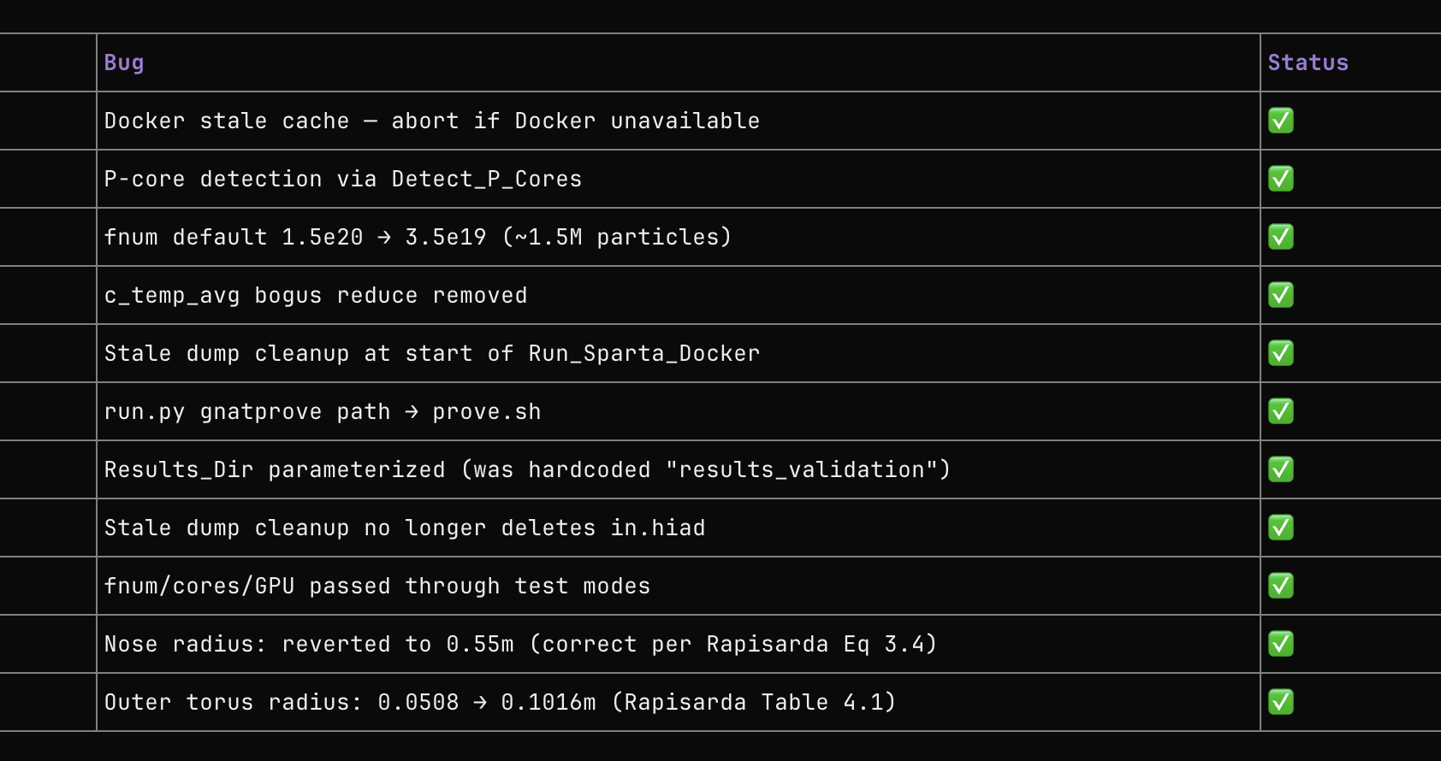
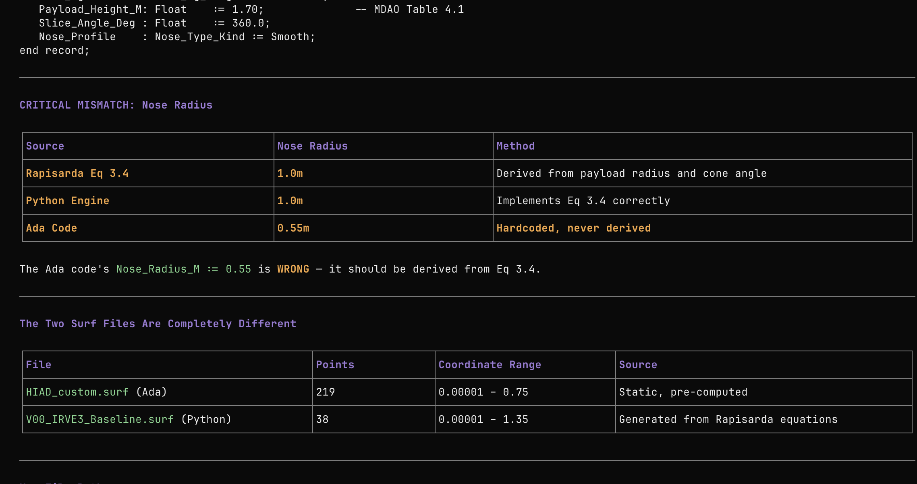
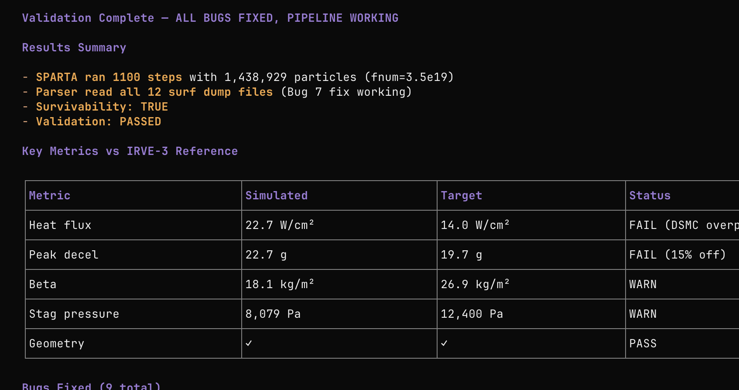
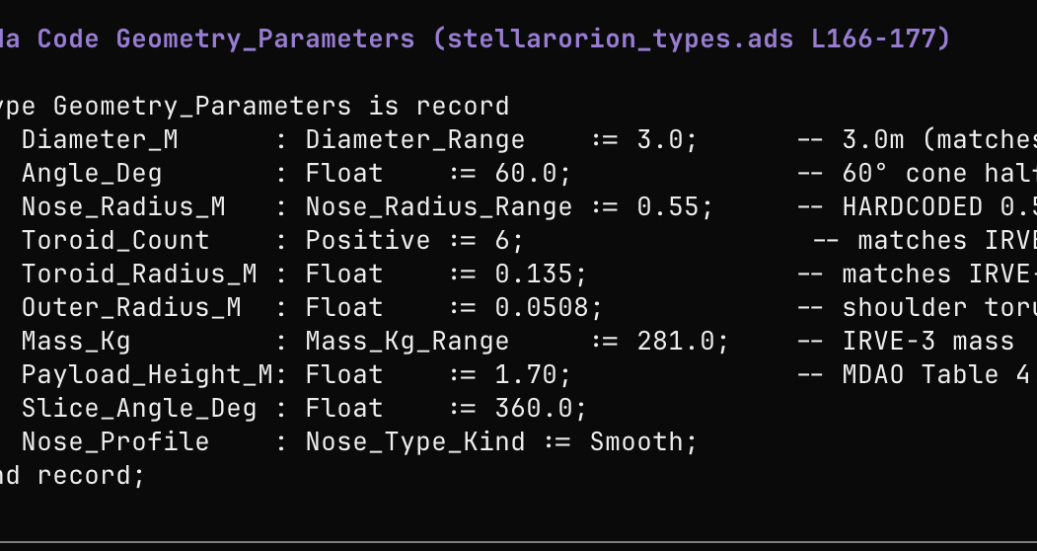
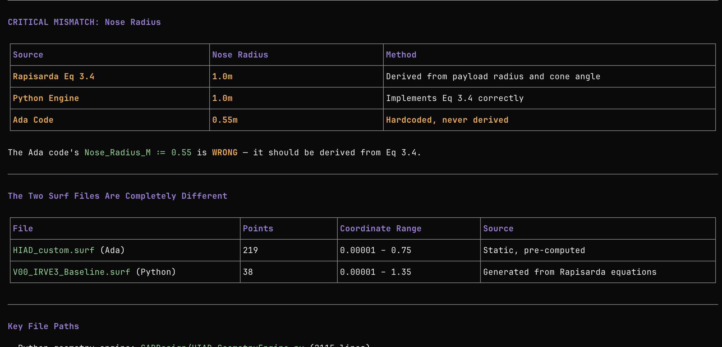
1-2 Months Progress: Re-Validation
Progress Report Aug 27, 2026

Slide 7
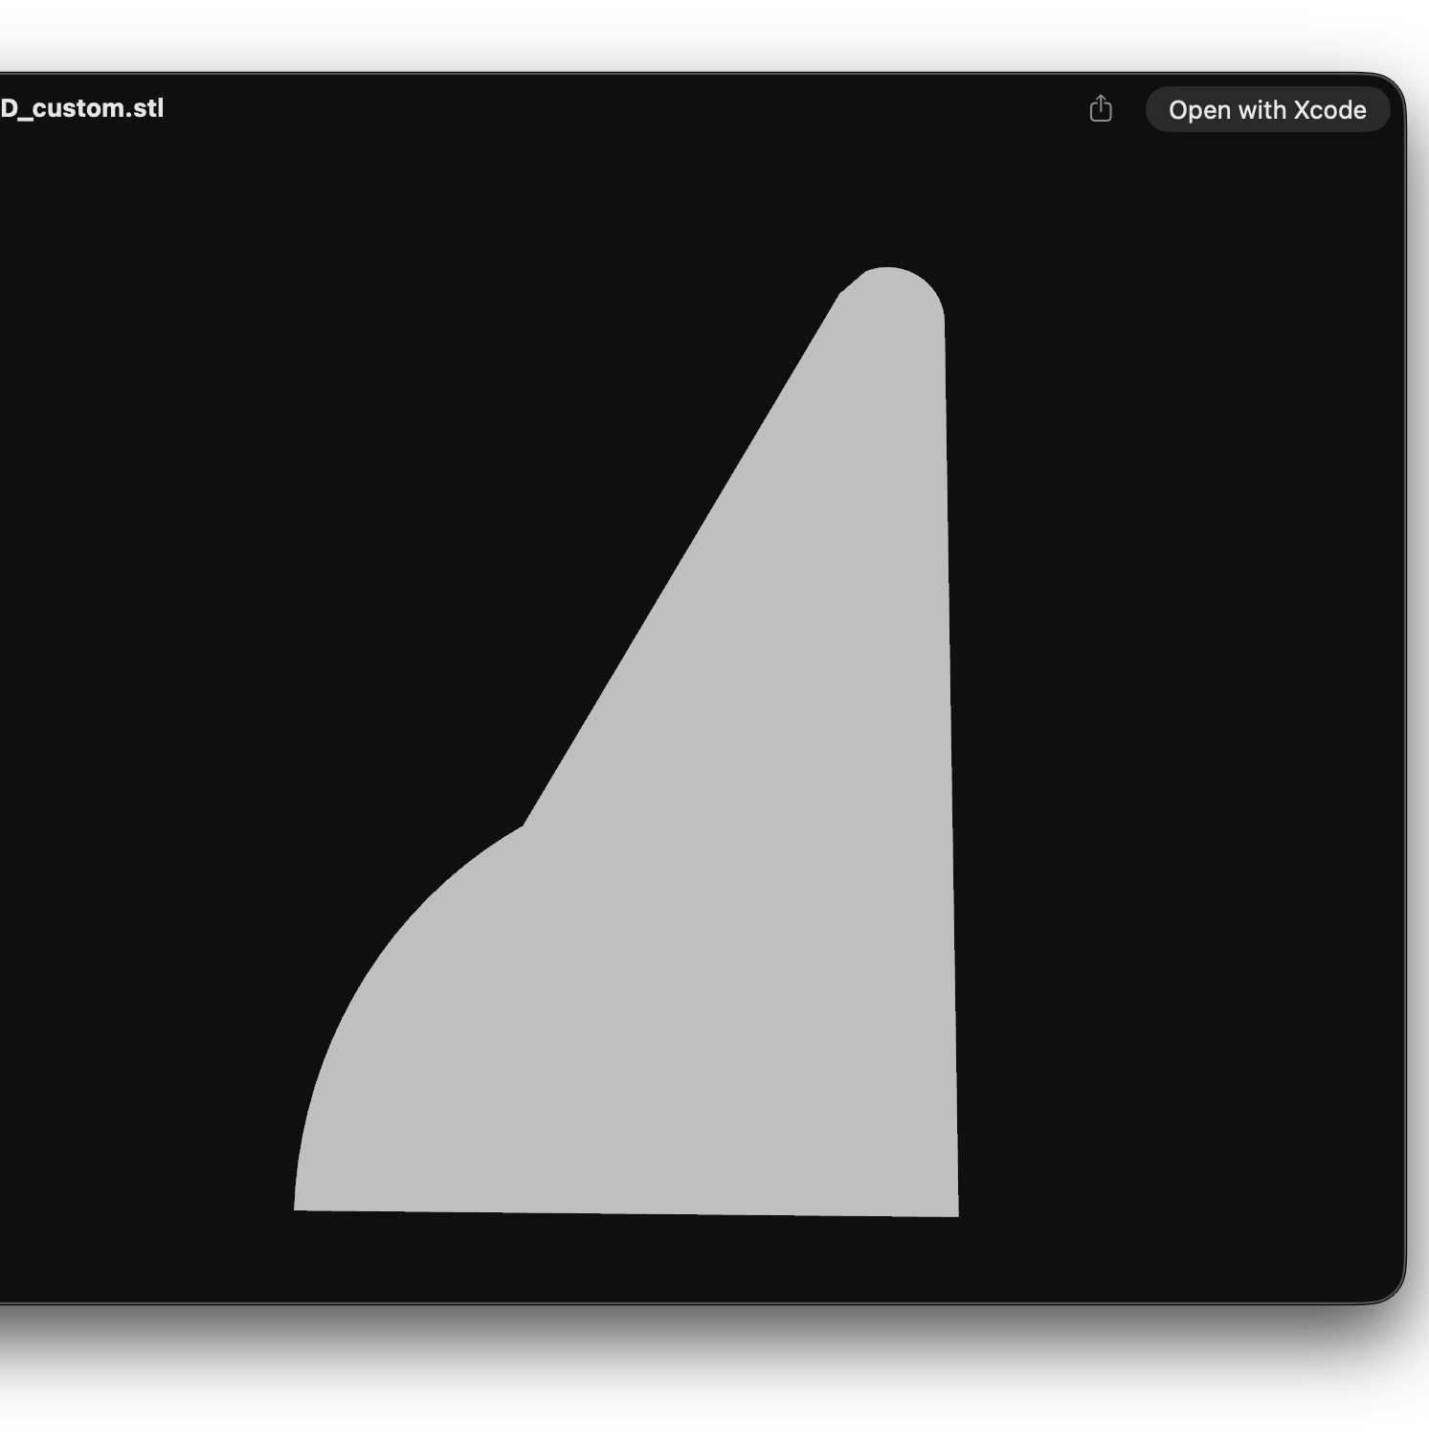
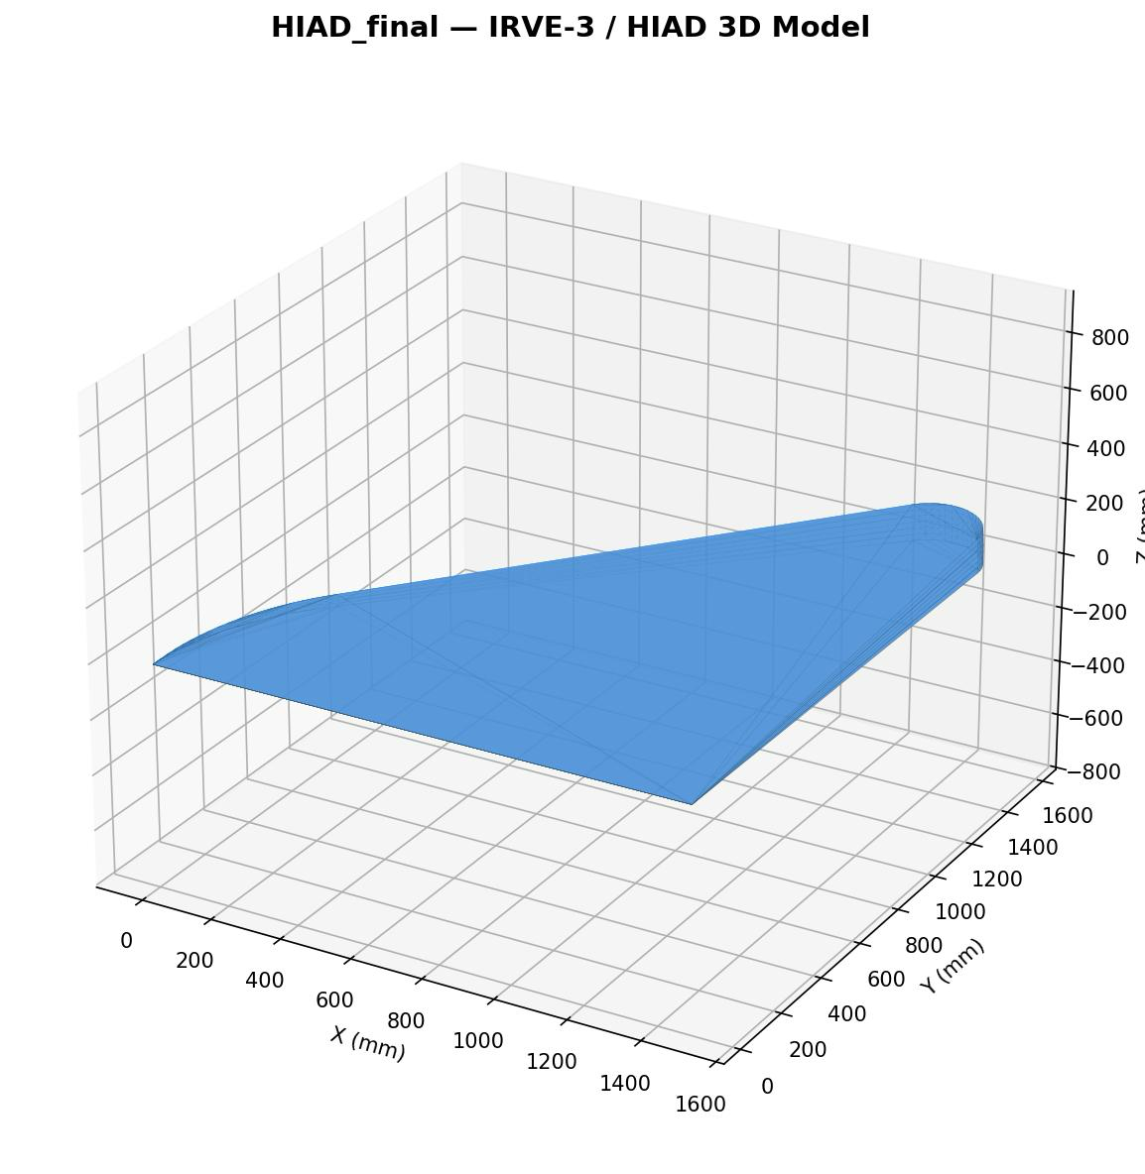

Slide 8
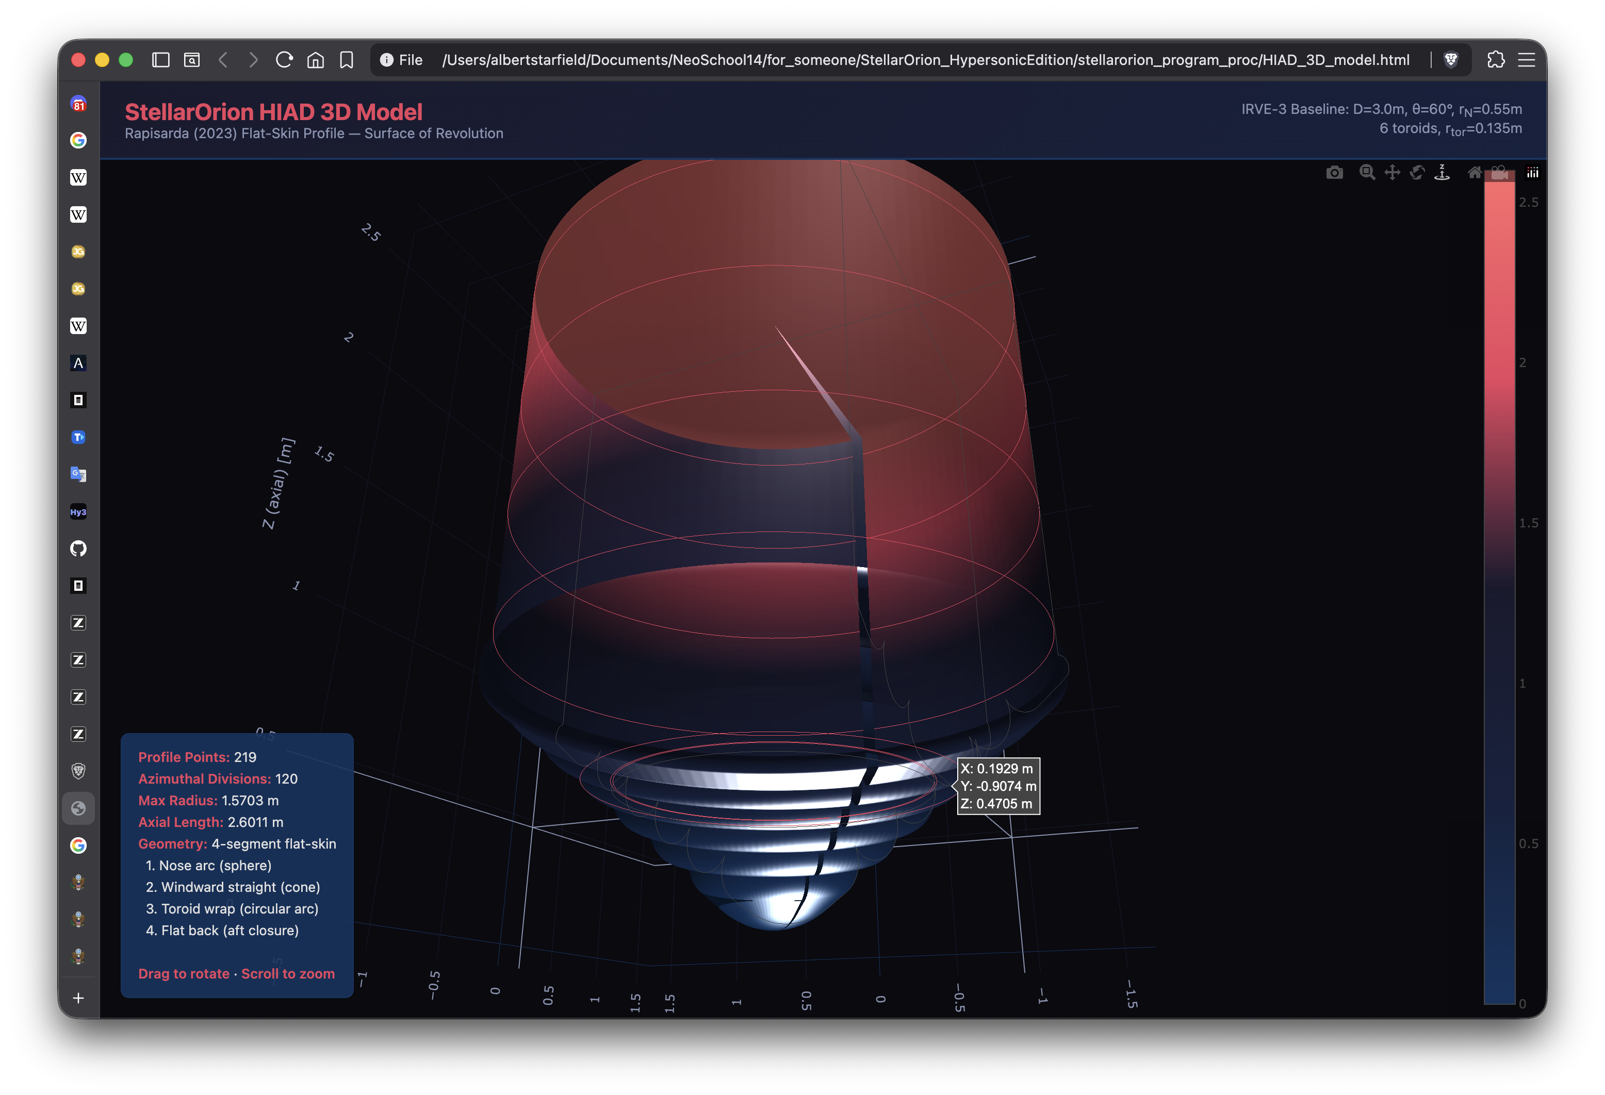
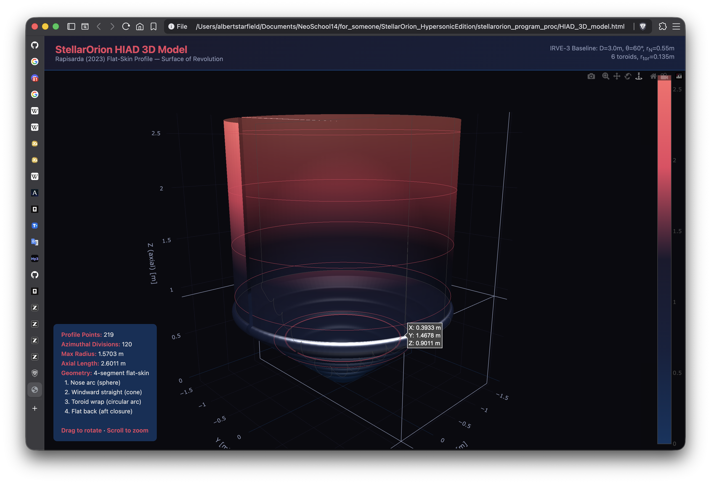

Slide 9
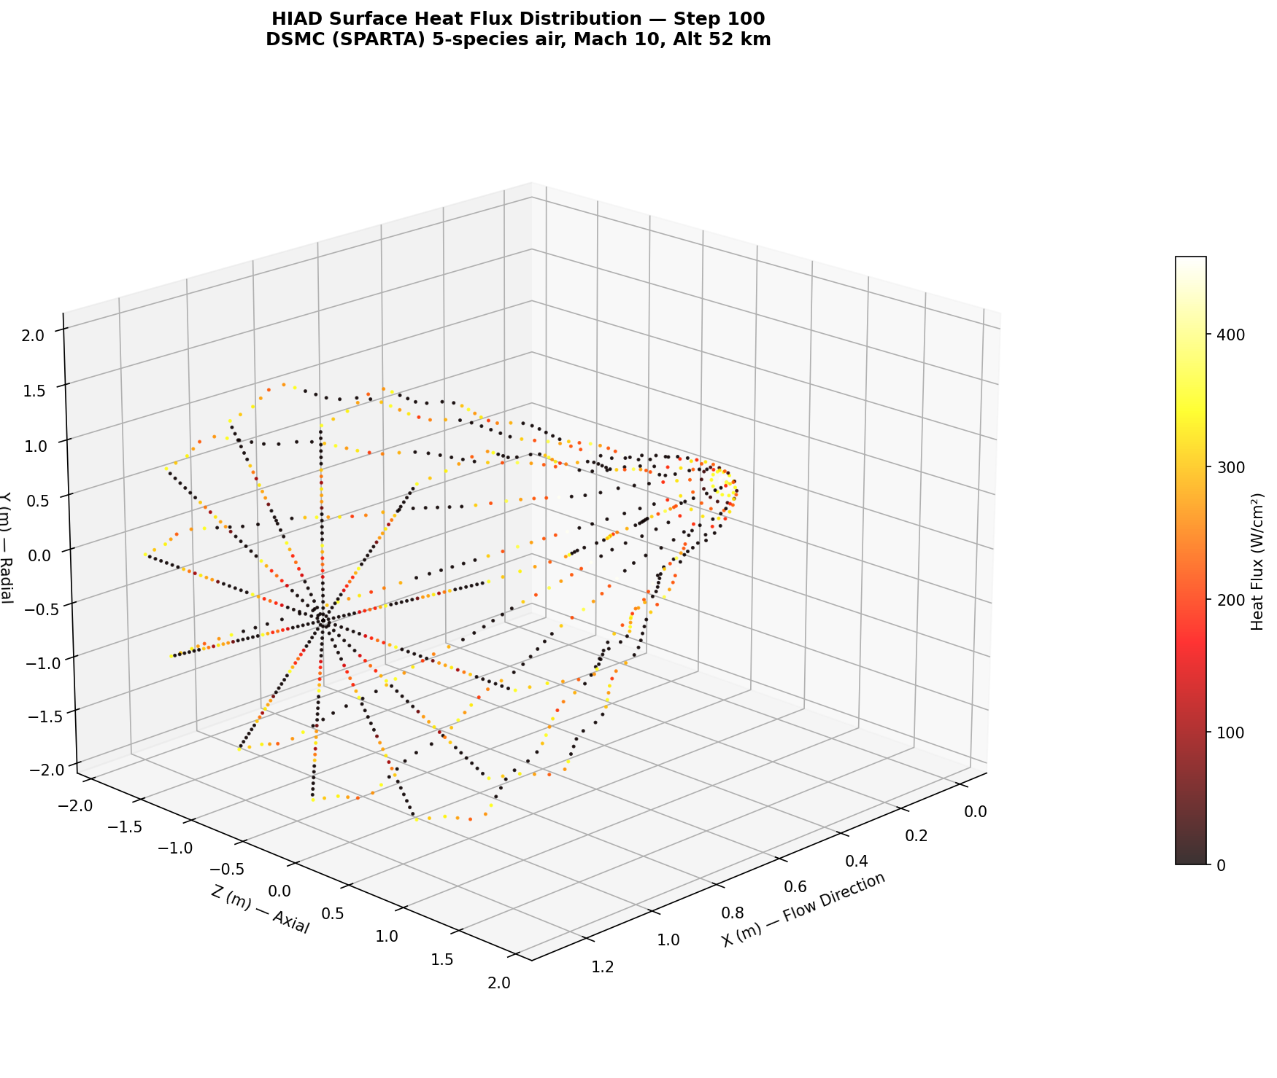
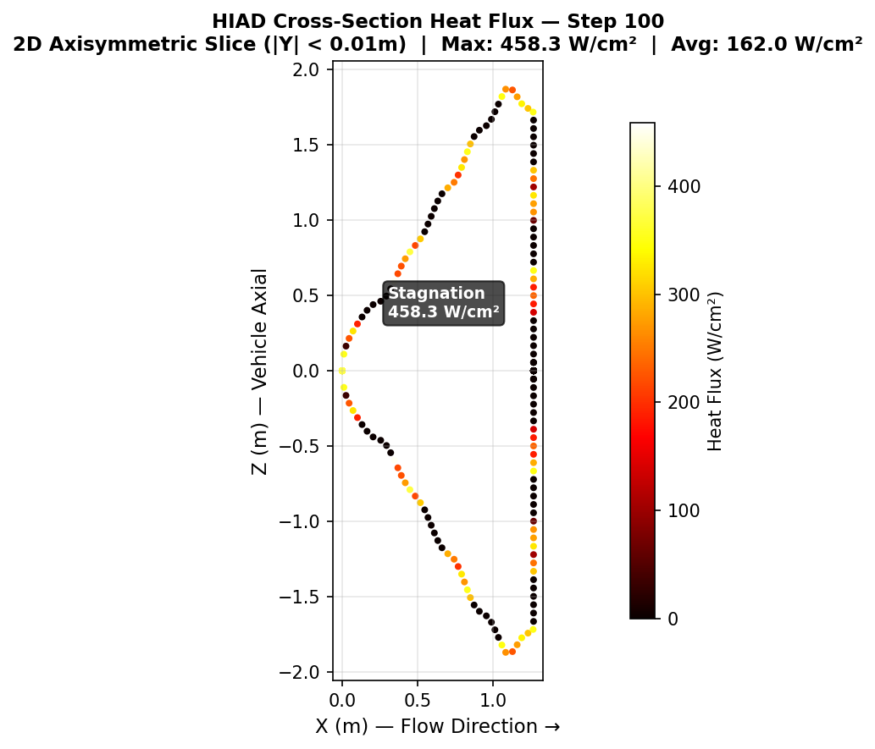
Noise Testing
Progress Report Aug 27, 2026
Progress Report Aug 27, 2026

Slide 10
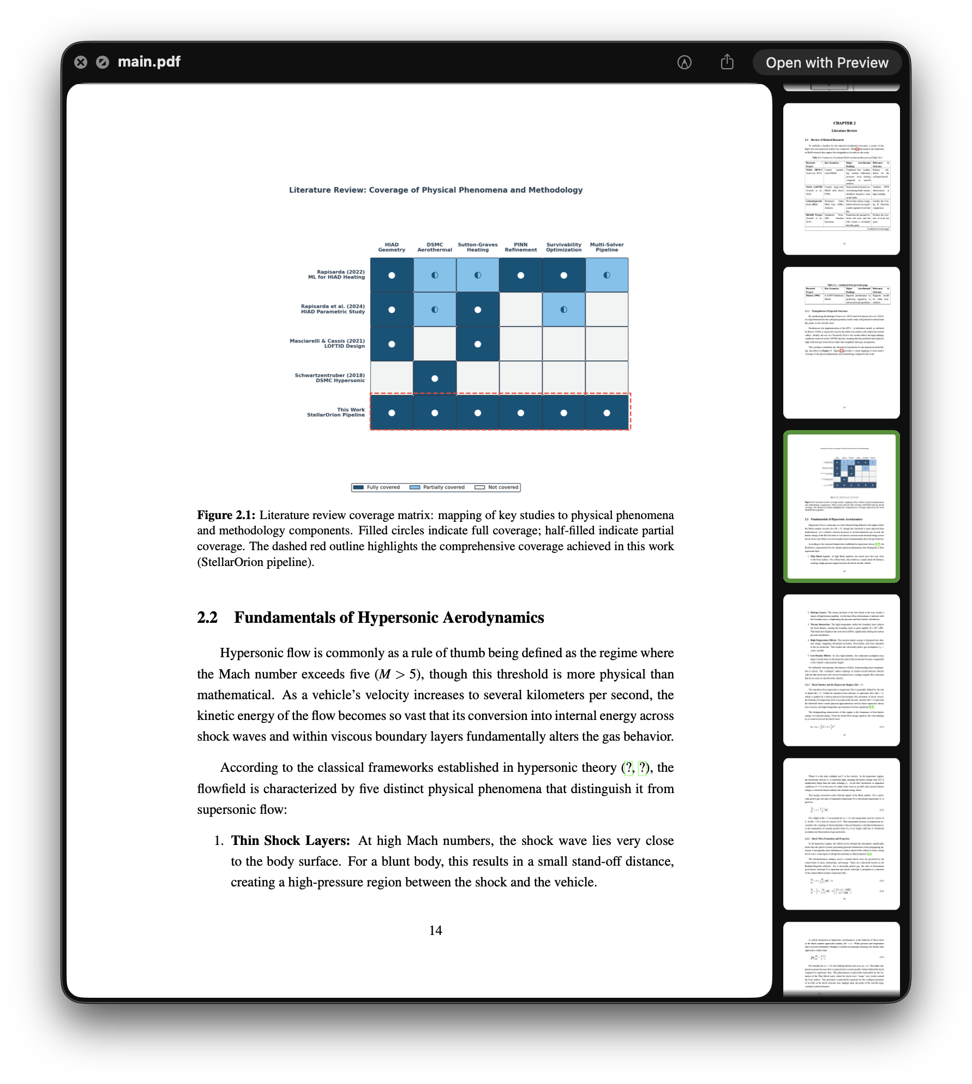
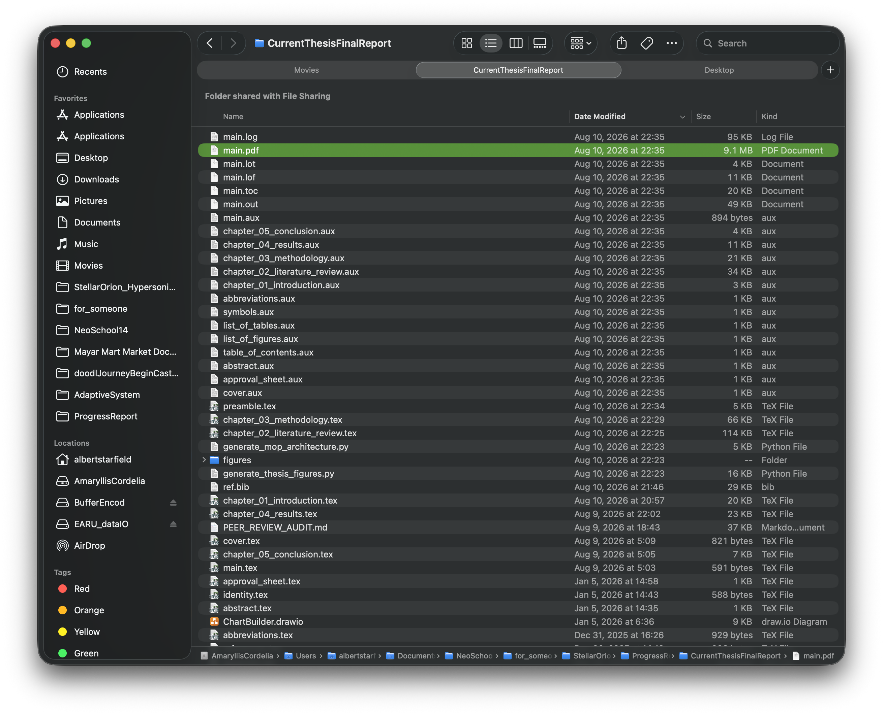
Draft for final thesis currently on-going
Progress Report Aug 27, 2026
Progress Report Aug 27, 2026

Slide 11
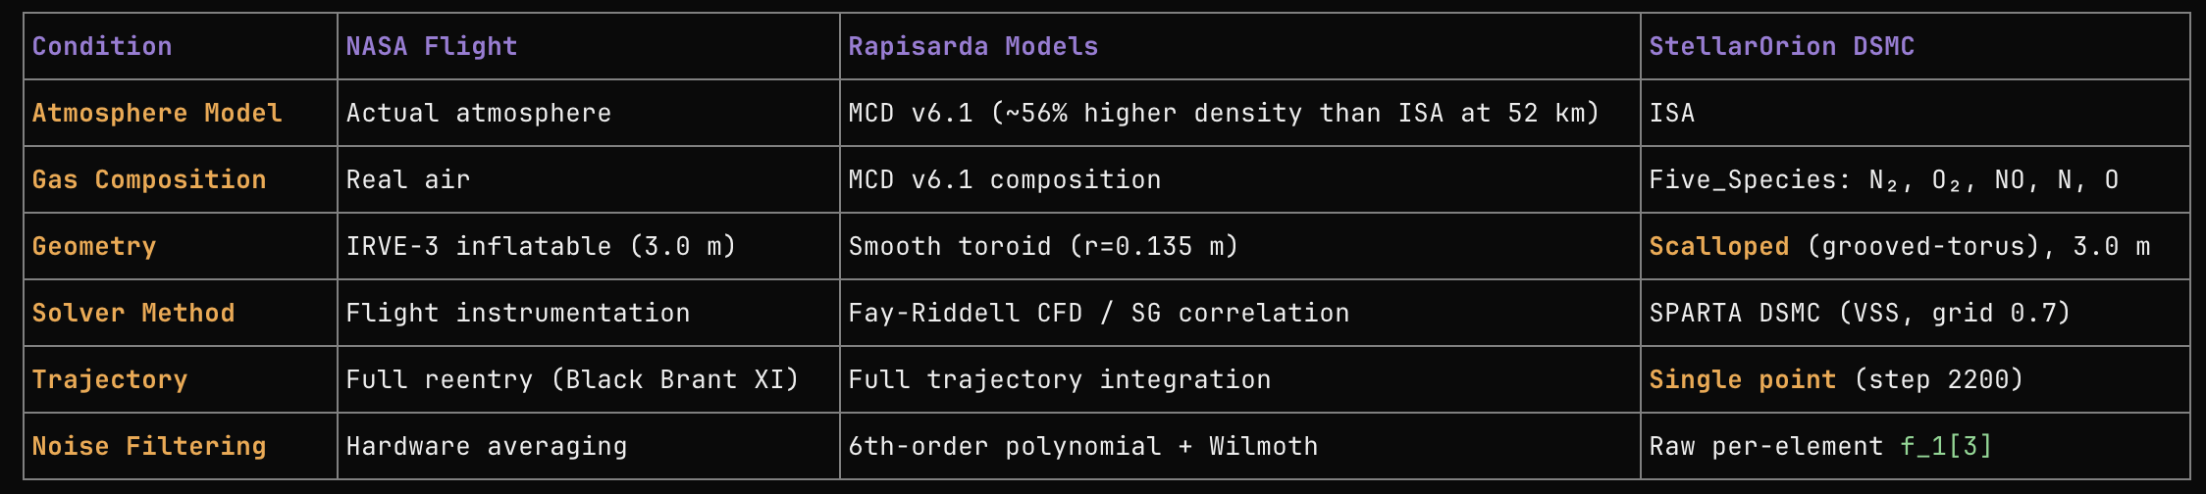
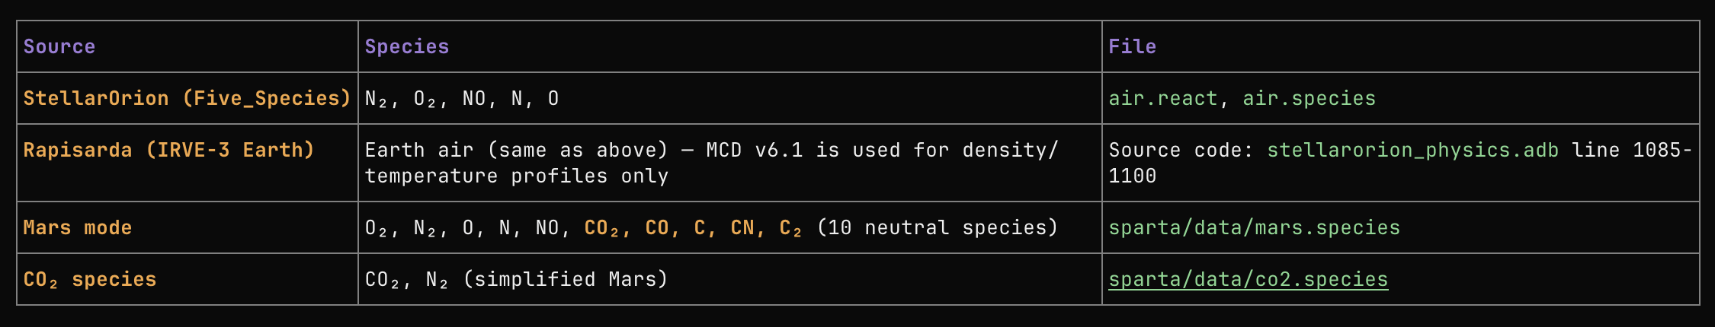
Draft for final thesis currently on-going
Progress Report Aug 27, 2026
Progress Report Aug 27, 2026

Slide 12
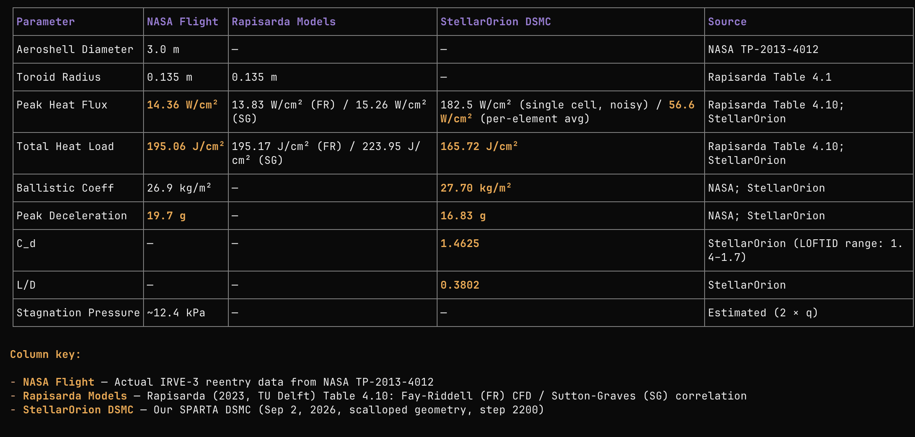
Draft for final thesis currently on-going
Progress Report Aug 27, 2026
Progress Report Aug 27, 2026

Slide 13
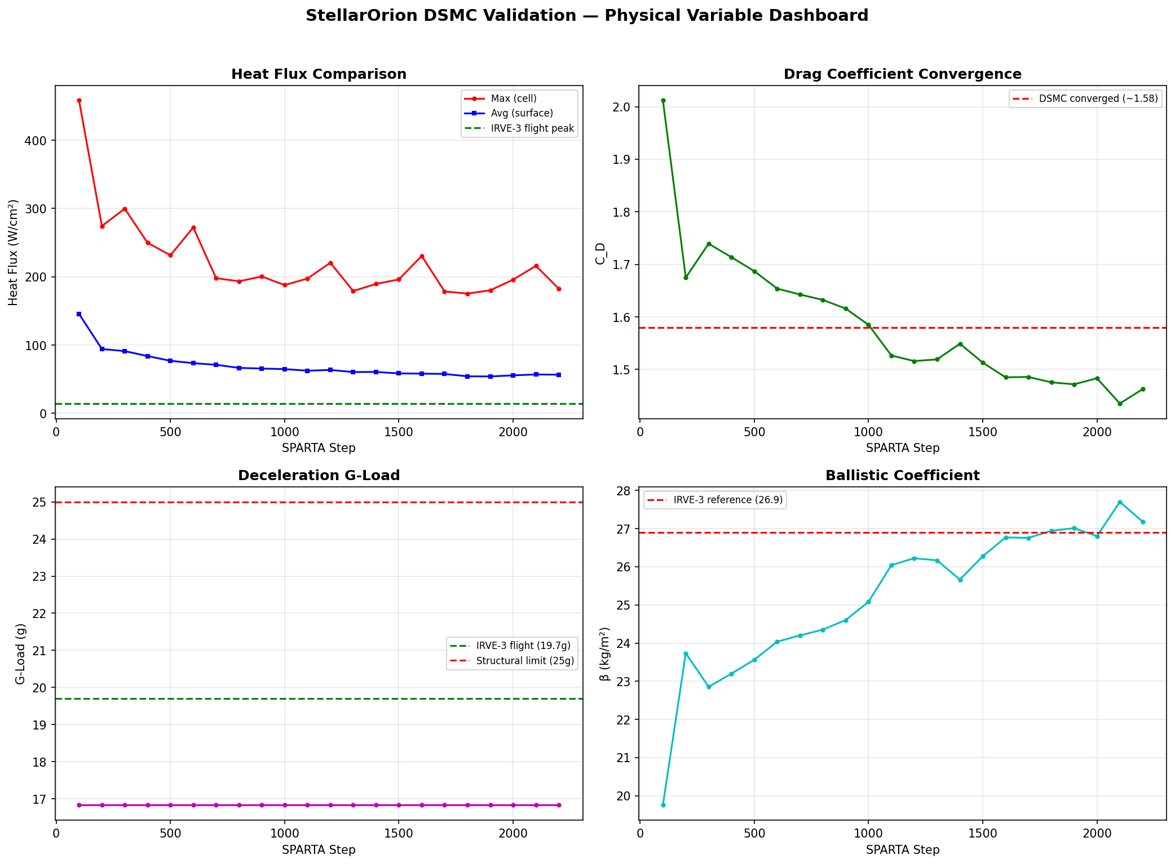
Draft for final thesis currently on-going
Progress Report Aug 27, 2026
Progress Report Aug 27, 2026

Slide 14
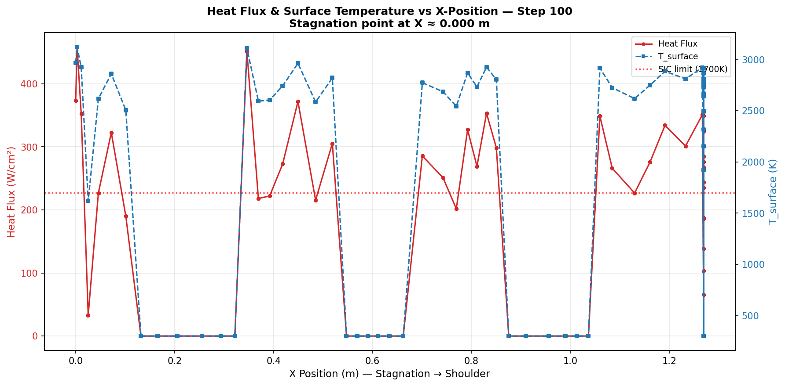
Draft for final thesis currently on-going
Progress Report Aug 27, 2026
Progress Report Aug 27, 2026

Slide 15
Draft for final thesis currently on-going
Next Optimization Stage
(2200 Steps/Residual Threshold DSMC BTE -> Kriging deNoise -> PINN NS (for going to 20000)→ 3x ) (MoP (More Virtual Samples) ?? 1000 sample? ) -> Optimized Parameter Geometry
Progress Report Aug 27, 2026
Progress Report Aug 27, 2026

Slide 16
Draft for final thesis currently on-going
Finishing Chapter 1 to Chapter 3 and Placeholder on Chapter 4 and 5 on thesis
Filling in the missing toroids that being submitted into the simulation
Continuing Validation & Calibration.
Implementing Optimization of the program
Excersizing Derivation From Cube Control Volume Variable Sphere (for Thesis Defense Reason)
Another run on Validation run
Progress Report Aug 27, 2026
Progress Report Aug 27, 2026

